Slide 1
Recommender Systems – An Introduction
Dietmar Jannach, Markus Zanker, Alexander Felfernig, Gerhard Friedrich
Cambridge University Press
Which digital camera should I buy? What is the best holiday for me and
my family? Which is the best investment for supporting the education of my
children? Which movie should I rent? Which web sites will I find interesting?
Which book should I buy for my next vacation? Which degree and university
are the best for my future?

Slide 2
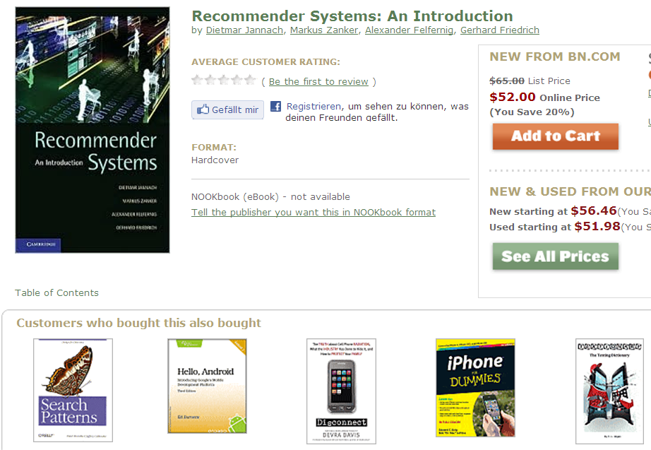

Slide 3
Agenda
Introduction
  Problem domain
  Purpose and success criteria
  Paradigms of recommender systems
    Collaborative Filtering
    Content-based Filtering
    Knowledge-Based Recommendations
    Hybridization Strategies

Slide 4



Slide 5
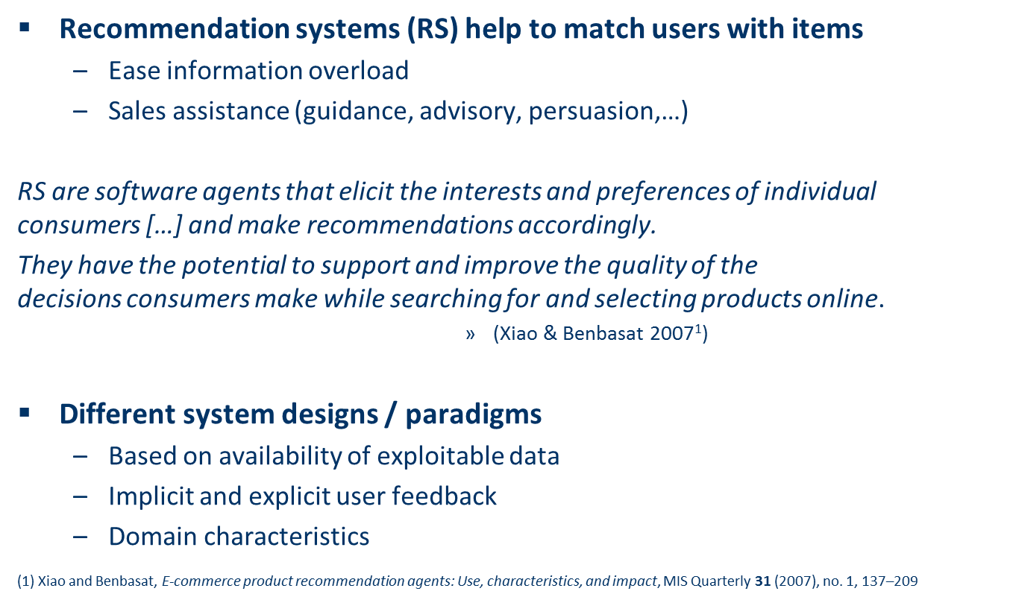



Problem domain

Slide 6
Purpose and success criteria (1)
Different perspectives/aspects
  Depends on domain and purpose
  No holistic evaluation scenario exists
Retrieval perspective
  Reduce search costs
  Provide "correct" proposals
  Users know in advance what they want
Recommendation perspective
  Serendipity – identify items from the Long Tail
  Users did not know about existence
Notes:
Could a RS be a persuasive technology? In fact depending on the application area RS are deployed to:

Slide 7
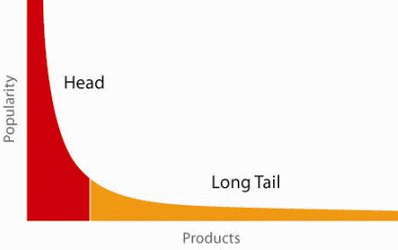
When does a RS do its job well?
"Recommend widely unknown items that users might actually like!"
20% of items accumulate 74% of all positive ratings
Items rated > 3 in MovieLens 100K dataset
Recommend items
from the long tail

Slide 8
Purpose and success criteria (2)
Prediction perspective
  Predict to what degree users like an item
  Most popular evaluation scenario in research
Interaction perspective
  Give users a "good feeling"
  Educate users about the product domain
  Convince/persuade users - explain
Finally, conversion perspective
  Commercial situations
  Increase "hit", "clickthrough", "lookers to bookers" rates
  Optimize sales margins and profit

Slide 9
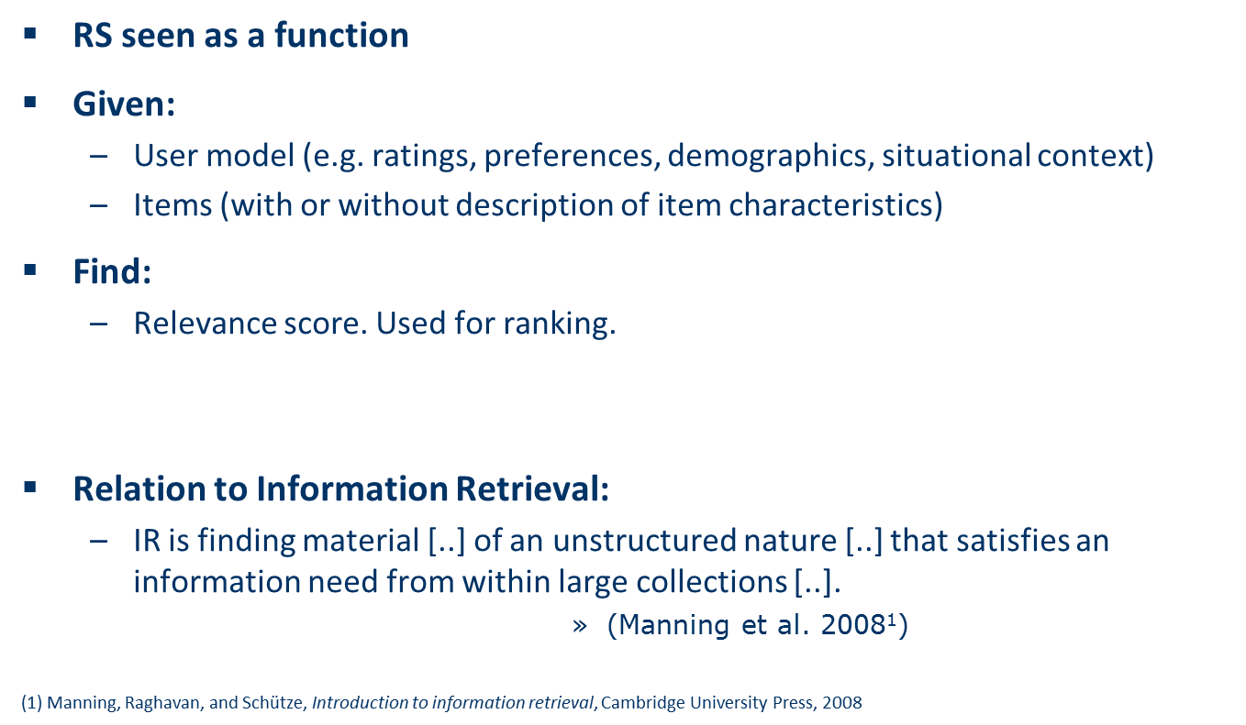
Recommender systems

Slide 10
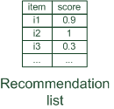
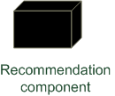
Paradigms of recommender systems
Recommender systems reduce information overload by estimating relevance

Slide 11


Paradigms of recommender systems
Personalized recommendations

Slide 12

Paradigms of recommender systems
Collaborative: "Tell me what's popular among my peers"

Slide 13

Paradigms of recommender systems
Content-based: "Show me more of the same what I've liked"

Slide 14


Paradigms of recommender systems
Knowledge-based: "Tell me what fits based on my needs"

Slide 15
Paradigms of recommender systems
Hybrid: combinations of various inputs and/or composition of different mechanism

Slide 16
Outlook
Part I (Basic Concepts)
  Basic paradigms of collaborative,
  content-based, and
  knowledge-based recommendation,
  as well as hybridization methods.
  Explaining the reasons for recommending an item
  Experimental evaluation
Part II (Recent Research Topics)
  How to cope with efforts to attack and manipulate a recommender system from outside,
  supporting consumer decision making and
  potential persuasion strategies,
  recommendation systems in the context of the social and semantic webs, and
  the application of recommender systems to ubiquitous domains

